Slide 1
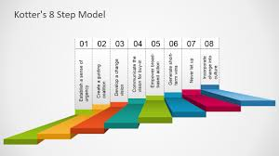
OC 6443
Change Leadership methods and Models
Week 4
Change: The 8-Step process

Slide 2
Organizational Change Practices
Which Practices Do We Employ?
Collective or collaborative approaches
Strategic Planning and goal setting
Stages of praxis
Ethical practices
How do they link to concepts of organizational change and leadership?

Slide 3
Collective or Collaborative Approaches
Institutional leadership and change practices
Coherence and
Agility
12 leadership systems (see page 81, text 1)
Keys to collective development
Professional development
Performance appraisal
Compensation systems

Slide 4
Collective or Collaborative Approaches cont’d
Organizational learning
Adapt to changes in the environment
Encourage experimentation and innovation
Continuous renewal of structures and processes
Keys to organizational learning (Senge):
Personal mastery
Mental models
Shared vision
Systems thinking

Slide 5
Collective or Collaborative Approaches cont’d
Shared power or empowerment
Leaders willing to share power
Delegate or distribute leadership
Best practices:
Decide if needs or wants empowerment
Create clear vision, goals, accountabilities
Develop others
Delegate decision making to followers
Lead by example
Make empowerment systemic through selection, appraisal, rewards, training, organizational structure

Slide 6
Strategic Planning
Traditional planning process
SWOT
Industry analysis
Updated vision, purpose, mission
Key areas:
Stakeholder analysis
Competitive advantages
Demographic changes
Social and lifestyle changes
Technology changes
Economic changes
Legislative/regulatory changes
Global changes

Slide 7
Stages of Praxis
Kurt Lewin’s force field model
When we recognize the old way is no longer effective due to crises, threats, new opportunities
Stages of change:
Unfreezing
Resistance to change:
Lack of trust
Belief its unnecessary
economic
Cost
Fear of failure
loss of power
Threat to values
Resentment of interference
Psychological Safety?

Slide 8
Stages of Praxis cont’d
Changing phase:
Create an image of a realistic, credible, and appealing future of the organization that
Energizes people
Inspires commitment
Gives meaning to work
Establishes a standard of excellence
The guiding coalition develops the strategy to achieve the change
How:
Dialogue, discourse, conversation
Creates a meaningful exchange, generates understanding
The spirit of inquiry is essential to dialogue – focuses on connections, embraces diverse perspectives, allows for shared understanding

Slide 9
Stages of Praxis cont’d
Refreezing or Anchoring New Approaches in the culture
How to influence culture, primary means:
Attention
Reaction to crises
Role modeling
Allocation of rewards
Criteria for selection of dismissal
Secondary means:
Design of systems/procedures
Structure
Rites and rituals
Facilities
Stories, legends, myths
Formal statements

Slide 10
Stages of Praxis cont’d
Scenario building
Uses facts, indicators and trends to project alternative futures
Provides a useful means for developing informed action
Appreciative Inquiry (AI)
Choose the positive for the inquiry
Inquire into life-giving forces
Locate themes that appear in the stories, develop for further inquiry

Slide 11
Stages of Praxis cont’d
E-Practices
How to aid in virtual environments
Training
Team building
Task and relational roles
Standards of communication
Process structuring
Frequent communication and feedback
Continuous emphasis on relational development
Anticipate unintended consequences

Slide 12
Stages of Praxis cont’d
Ethical Practices
Attend to the leaders and followers take into account their actions in relationship to others
Ethical decisions and practices
What should be done in regards to coworkers and customers
Moral compass
Authenticity, trust, reciprocal care
Beware ‘bogus’ empowerment
Openness and transparency

Slide 13
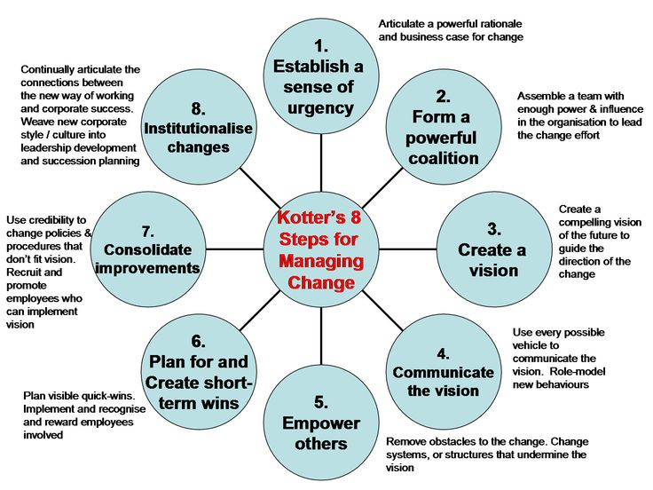

Slide 14
Driving New Initiatives and Change in the Organization
Eight Steps to Driving Change *:
1. Establish a Sense of Urgency
Building the Case ~ Resistance to change
2. Build a Coalition
Identify stakeholders and build alliances
3. Create a Shared Vision
4. Communicate Vision Repeatedly
5. Empowering Others to Act on the Vision
6. Planning for and Creating Short Term Wins
Reinforce the Change
Institutionalizing New Approaches
Leading Change, John P. Kotter, HBS Press, 1996
The Heart of Change Field Guide, Dan S. Cohen, John P. Kotter, HBS press, 2005

Slide 15
Leading Change Model
Establish a Sense of Urgency
Examining market or demographic realities
Identifying and discussing crises, potential crises or major opportunities
Why might people fail here:
Underestimating how hard it can be to drive people out of their comfort zones
sometimes grossly overestimate how successful they have already been in increasing urgency
sometimes lack the patience
Forming a Powerful Guiding Coalition
Assembling a group with enough power to lead the effort
Can be as small as 3-5 individuals, work as a team

Slide 16
Leading Change Model
Creating a Shared Vision
Picture of the future, easy to communicate, and appeals to staff, leaderships and stakeholders
Developing strategies for achieving that vision
Communicate Vision Repeatedly
Leading change is usually impossible unless large numbers of people are willing to help
How? Organizational newsletters, Quarterly management meetings…
Use every possible channel, especially those that are being wasted on non-essential information

Slide 17
Leading Change Model
Enable Your Team to Achieve the Vision
Getting rid of obstacles
Changing systems or structures that undermine vision
Planning for and Creating Short Term Wins
Planning for visible performance improvements
Creating the improvements
Recognizing and rewarding employees involved in the improvement

Slide 18
Leading Change Model
Reinforce the Change…Producing still more change
Using increased credibility to change systems, structures and policies that don’t fit
Hiring, promoting, and developing employees who can implement the vision
Reinvigorate process with new projects and themes
Institutionalizing New Approaches
“…the way we do things around here.”
Articulating the connections between the new behaviors and organizational progress/success
Developing the means to ensure leadership development and succession

Slide 19

Weave into the Fabric of the Organization
eliminate the perception of “add on”
establish the business case
link to quality of care
legitimize in policy, structures, practices, procedures, & resources
set bench marks & measure progress at regular intervals
assure it is woven into the “culture” of the organization
Slide Source: The National Center for Cultural Competence, 2004

Slide 20

PAU!

Slide 21
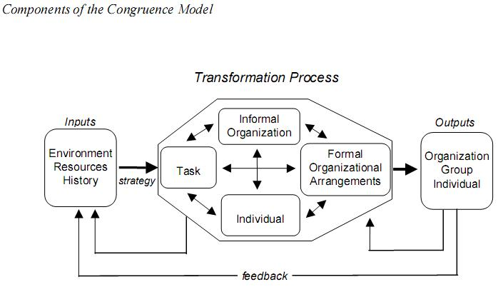

Slide 22
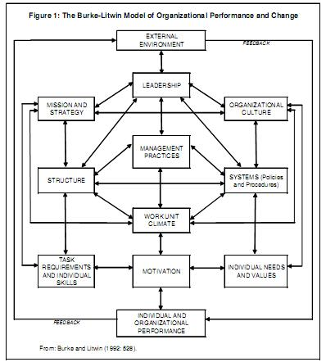

Slide 23
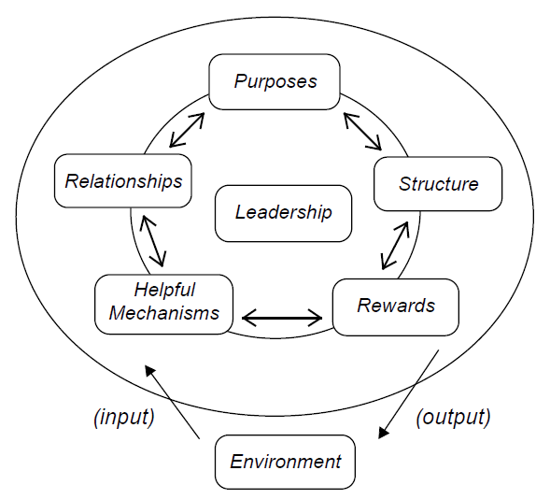

Slide 24
